Slide 1
Technical session 6: AASB Not-for-Profit Financial Reporting Framework
Technical Session 6
Fridrich Housa - Deputy Technical Director
Maggie Man - Project Manager

Slide 2
Agenda
AASB strategic objectives
Evidence-based and consultative approach
Journey to developing the consultation document
Current landscape and key issues and benefits
Not-for-profit financial reporting framework
Challenges in standard-setting in Australia
Current and proposed NFP financial reporting framework
How the Tier 3 accounting requirements were developed
Proposals for Tier 3 accounting requirements
Next steps - consultation

Slide 3
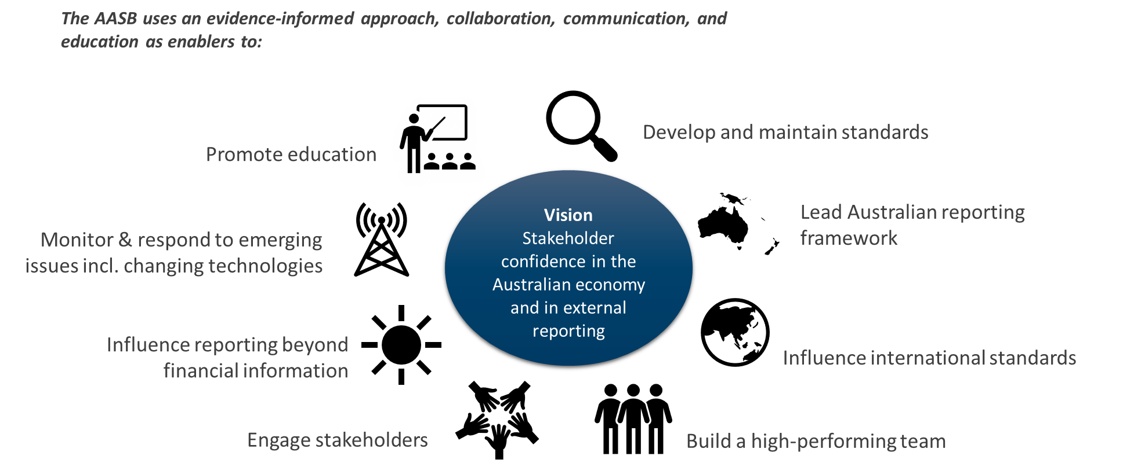
AASB strategic objectives
NFP FRF’s focus

Slide 4
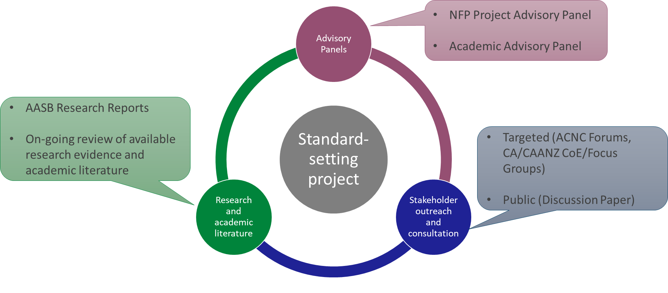
Evidence-based and consultative approach

Slide 5
Journey to developing the Consultation Document
Research:
AASB Research Report 5 Financial Reporting Requirements Applicable to Charities
AASB Research Report 10 Legislative and Regulatory Financial Reporting Requirements,
AASB Research Report 11 Review of Special Purpose Financial Statements: Large and Medium-Sized Australian Charities
AASB Research Report 14 Literature Review: Service Performances Reporting For Not-For-Profits
AASB Research Report 16: Financial Reporting by Non Corporate or Small Entities
Stakeholder outreach:
Invitation to Comment 39 (May 2018)
Engagement with Consumer Affairs Forum (November 2018)
Initial targeted consultations with various stakeholders including staff of federal, state and territory regulators (2020)
Feedback from AASB NFP Project Advisory Panel
On-going outreach including regulators
Board developing a discussion paper, including forming preliminary views on aspects of a revised differential reporting framework including:
Not developing 4th reporting tier;
No changes to existing Tier 1 and Tier 2 requirements;
Removal of SPFS;
Not developing reporting thresholds ;
Service performance reporting developed as part of a separate project; and
Timing of proposal.
Pre 2021
2021/
H1 2022
Q3 2022
H1 2023 onwards
Board considers feedback on its DP and decides its next steps (e.g. develop an ED)
Discussion Paper exposed for public comment
OFFICIAL

Slide 6
Current landscape and key issues and benefits – Not-for-Profit Financial Reporting Framework
Varied financial reporting requirements based on state of incorporation
Significant lower level of R&M compliance in charities’ SPFSs
Resulting lack of comparability, consistency and transparency between financial reports
Self-assessment of reporting entity and GPFS vs SPFS & significant judgement
Diverse population of entities preparing financial statements
Current Landscape and Key Issues
Stakeholders requests to report on impact, transparency and accountability often in the form of financial and non-financial information
Needs of the users compared to costs to preparers & ability to assure
Source: Invitation to Comment No 39, AASB Research Report No 5, 10 , 11 , 14 and 16, AASB DP Improving Financial Reporting for Australian Charities, ACNC Legislation Review 2018

Slide 7
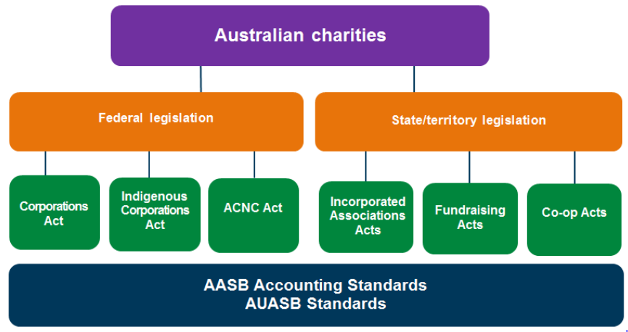
Current landscape and key issues and benefits - Challenges in standard setting in Australia
Australian not-for-profits
Determined by regulators and legislative requirements
Determined by standard setter

Slide 8
Current & proposed Australian NFP Financial Reporting Framework
EXISTING FRAMEWORK
PROPOSAL FOR FUTURE
Tier 1 Australian Accounting Standards – Full IFRS
IFRS equivalent requirements and include requirements that are specific to Australian entities
Entities with public accountability and required by legislation to prepare financial statements, for example:
Tier 2 Australian Accounting Standards – Simplified Disclosures
Recognition and measurement requirements of Tier 1 but substantially reduced disclosure requirements.
Australian Government and State, Territory and Local Governments
Proposed Tier 3 Australian Accounting Standards
Simplified recognition and measurement requirements to Tier 1 and Tier 2 with disclosures complementary to Tier 3 R&M requirements
Listed companies, financial institutions
For-profit public companies (consolidated revenue >$50 million, consolidated gross assets >$25 million, 100+ employees)
For-profit entities without public accountability and NFP private and public sector entities, for example:
Charities
Other not-for-profit entities
Smaller Not-for-profit private sector entities, for example:

Slide 9
How the Proposed Tier 3 accounting requirements were developed
Project objective
To develop a simple, proportionate, consistent and transparent financial reporting framework for application by not-for-profit private sector entities
Tier 3 reporting requirements – primary development objective
To develop simplified financial reporting requirements that meet the needs of users of financial statements of smaller not-for-profit private sector entities
Identify relevant matters for inclusion in a Discussion Paper
Principles for the development of Tier 3 reporting requirements
AASB Not-for-Profit Entity Standard Setting Framework
Tier 3 GPFS must provide useful information to users
Consistency with Tier 2 reporting requirements desirable
Leverage information that management uses to make decisions
Cost/benefit balance is appropriate
Consider possible financial reporting ‘simplifications’
Evaluate possible financial reporting ‘simplifications’ against Board-agreed principles for development of Tier 3 reporting requirements
Board forms its preliminary view on how an entity should account for a particular matter

Slide 10
Proposals for Tier 3 accounting requirements
Key topics that proposes simplifications to the existing classification, recognition and measurement requirements
Consolidation
Accounting policy choice
Non-financial assets acquired at significantly less than fair value
Accounting policy choice to initially measure non-financial assets:
Consolidated financial statements
Separate financial statements with disclosures of parent entity’s significant relationships
At cost
At fair value

Slide 11
Proposals for Tier 3 accounting requirements
Key topics that proposes simplifications to the existing classification, recognition and measurement requirements
Leases
Lease expenses (income) recognised on a straight-line basis over the lease term, unless another systemic basis more faithfully representational
Income (including revenue)
Income deferred when there is a common understanding evidenced between resources provider to use the resources in a particular way
Right of use assets are not recognised

Slide 12
Proposals for Tier 3 accounting requirements
Key topics that proposes simplifications to the existing classification, recognition and measurement requirements
Employee benefits
No discounting for short and long term employee benefits
Financial instruments
Simplification for financial instruments that are basic (e.g. cash, accounts receivable, units held in managed investment schemes)
Financial instruments that are more complex refer to AASB 9 Financial Instruments (e.g. purchased debt instruments, interest rate swaps)

Slide 13
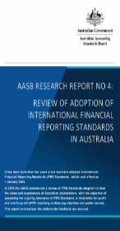
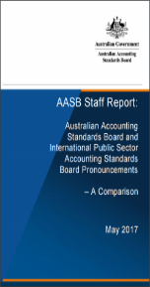
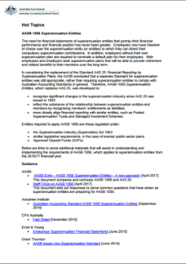
Next steps – consultation
Variety of materials supporting the Discussion Paper
Several ways to provide feedback
12 page Snapshot – overview of Discussion Paper in simple language
Online survey
Easily accessible via any device and written in simple language
Outreach events
Outreach through comment period (Virtual and in-person)
Hot Topics page – dedicated with all the information relating to the project
Written submission
Submission via AASB website
Pre-recorded AASB staff education session
Standard -setting process
Stakeholder outreach and consultation

